Slide 1

Flipkart Air Conditioner Analysis
Title: Web Scraping and Exploratory Data Analysis of Flipkart Air Conditioner Market

Slide 2
Agenda:
INTRODUCTION
BUSINESS PROBLEM
OBJECTIVE
TOOLS USED
WEB SCRAPPING
DATA CLEANING STEPS
DATA VISUALIZATION
CONCLUSION

Slide 3

Introduction:
Flipkart is a leading e-commerce platform in India offering a wide range of products, including air conditioners, with detailed specifications, prices, ratings, and reviews.
The platform allows customers to compare features and prices, helping them make informed purchasing decisions.
Flipkart also provides discounts, deals, and convenient delivery options, making AC shopping easier and more accessible.

Slide 4
Business Problem:
The market has many air conditioner models,
making it hard for customers to choose the right one.
Identifying the best value for money
among various options is confusing.
Prices, features, ratings, and reviews differ widely,
adding to the selection challenge.
This study analyzes the AC dataset
to find features affecting price and satisfaction.

Slide 5
Objectives:
To analyze and compare air conditioner models on Flipkart,
considering features, prices, ratings, and customer reviews.
To identify key factors affecting price and customer satisfaction,
helping buyers make informed purchasing decisions.
To provide insights for selecting the right AC that ensures value for money and convenience.

Slide 6
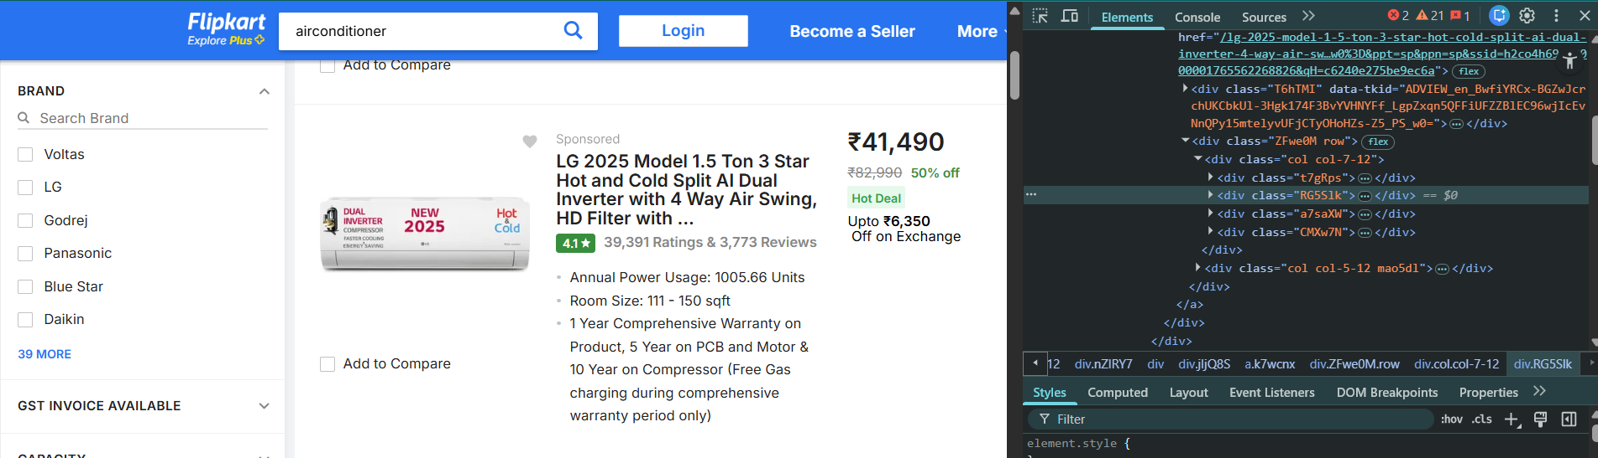
Web Scraping:
Selected Flipkart as the data source for air conditioners and used browser developer tools to identify relevant HTML tags for scraping.
Extracted product data (features, prices, ratings) using Requests and BeautifulSoup by sending HTTP requests to fetch web pages.
Conducted Exploratory Data Analysis (EDA) to uncover trends in product features, pricing, and customer reviews.

Slide 7
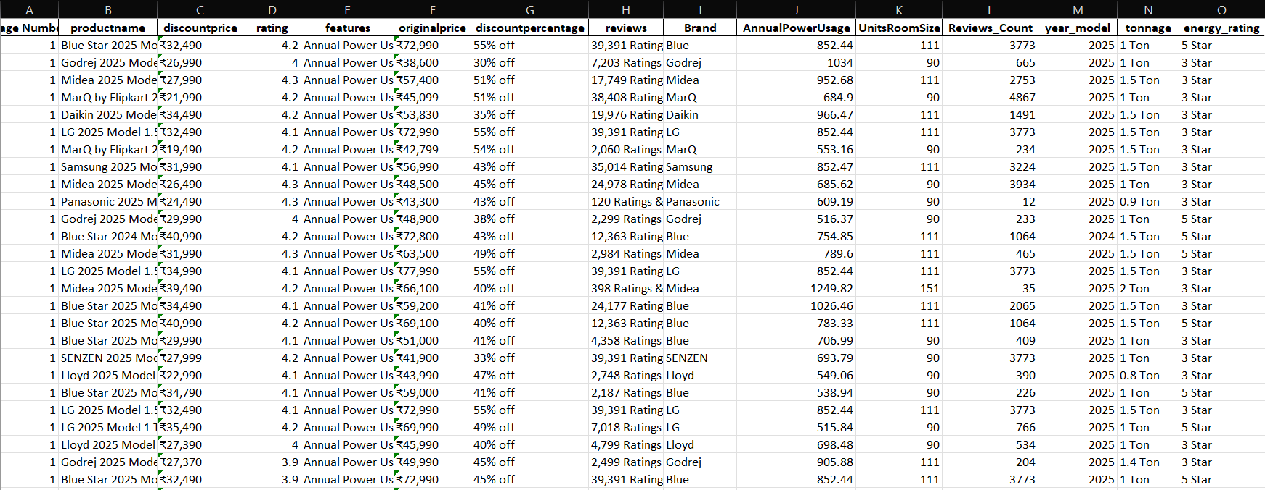
Dataset:
Rows:- 2288
Columns:-18

Slide 8






Libraries Used:

Slide 9

Data Cleaning Steps:
Cleaned raw text data by removing unwanted symbols and words (₹, commas, “Ratings”, “off”) and converting price, discount, rating, and review columns into proper numeric formats.
Standardized product attributes by extracting brand names, converting AC capacity (tonnage), energy ratings, annual power usage, and room size into consistent, analysis-ready values.
Handled missing and inconsistent values by replacing NaN entries, fixing data types, and renaming columns to improve overall dataset quality and readability.

Slide 10
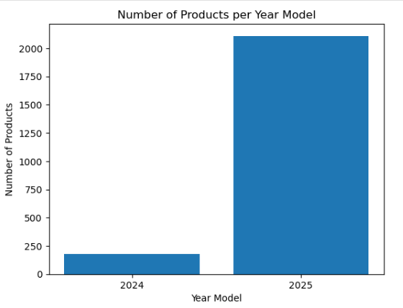
Univariate Analysis:
The dataset is dominated by 2025 model air conditioners, with significantly more products than 2024 models
Very few 2024 models are available, indicating limited listings of older products on the platform.
This shows that Flipkart mainly focuses on newer AC models, offering customers the latest products and technologies.

Slide 11
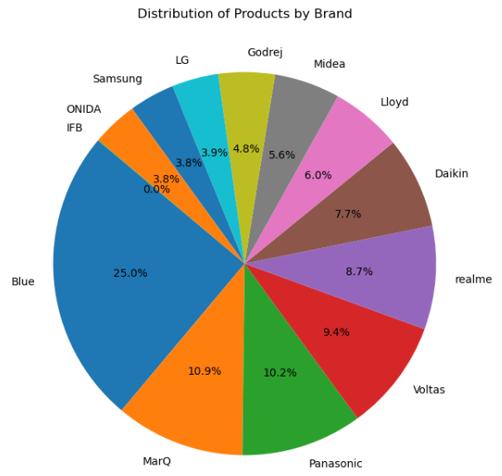
Univariate Analysis:
Blue holds the largest share at 25%, making it the most prominent brand in the product distribution.
Brands like MarQ (10.9%), Panasonic (10.2%), and Voltas (9.4%) have significant but much smaller shares compared to Blue, indicating a competitive mid-tier market.
Several brands, including IFB (0%), ONIDA (3.8%), LG (3.9%), and Godrej (4.8%), have relatively minor representation, suggesting limited market presence.

Slide 12
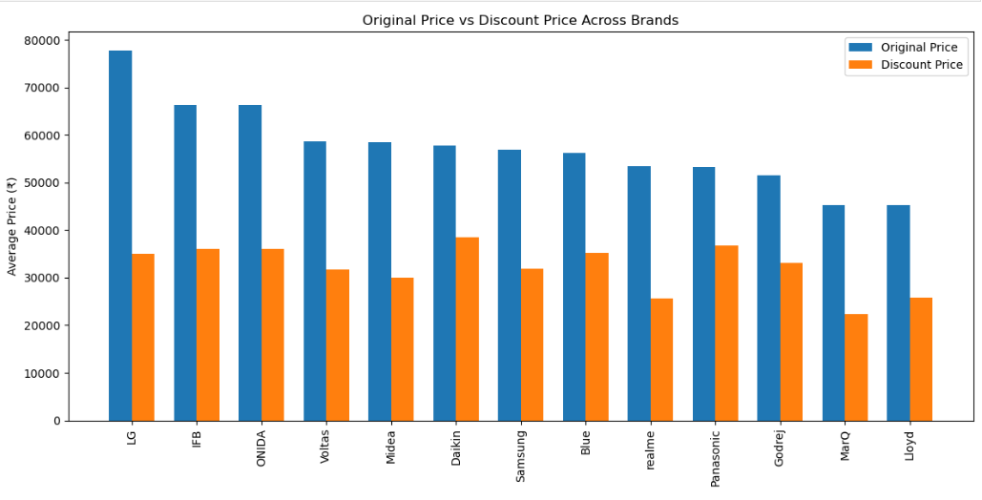
Bivariate Analysis:
LG and IFB are positioned as premium brands with the highest original prices, while MarQ and Lloyd are clearly more budget-friendly options.
Significant discounts are offered across all brands, indicating strong promotional pricing strategies on Flipkart to attract customers.
Even after discounts, premium brands such as Daikin and Samsung remain relatively expensive, whereas budget brands continue to focus on affordability to appeal to price-sensitive buyers.

Slide 13
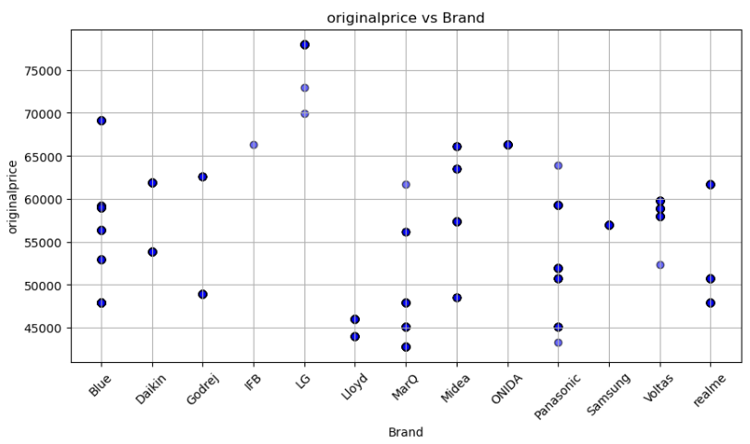
Bivariate Analysis:
LG and Blue Star show the highest original prices, indicating they are positioned as premium AC brands.
LG and IFB are premium brands with the highest original prices, while MarQ and Lloyd target the budget segment with the lowest prices.
Voltas, Samsung, Panasonic, and Midea cluster in the ₹50,000–₹60,000 range, indicating intense competition in the mid-price segment.
Wide price variation and overlap across brands suggest multiple product models and competitive pricing even among premium brands.

Slide 14
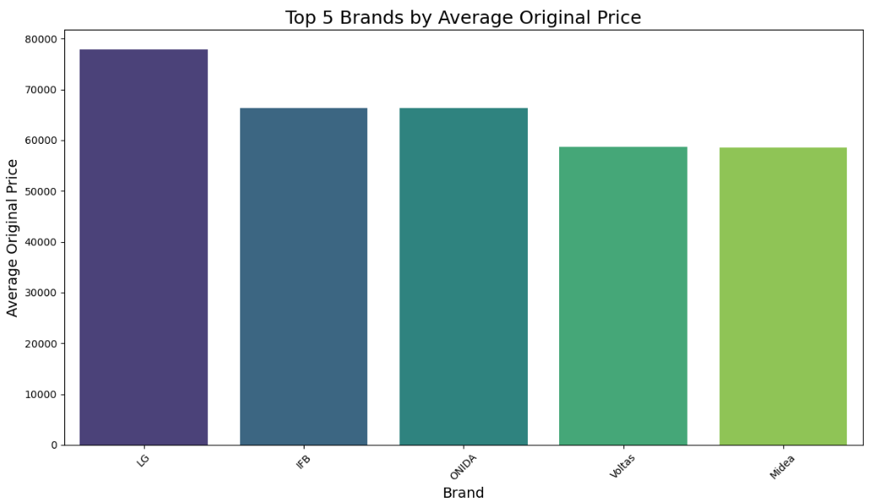
Bivariate Analysis:
LG has the highest average original price, clearly leading the premium segment among all brands.
IFB and ONIDA follow closely, indicating strong premium positioning with similar pricing levels.
Voltas and Midea complete the top five but are priced slightly lower, positioning them at the upper end of the mid-range segment rather than true premium.

Slide 15
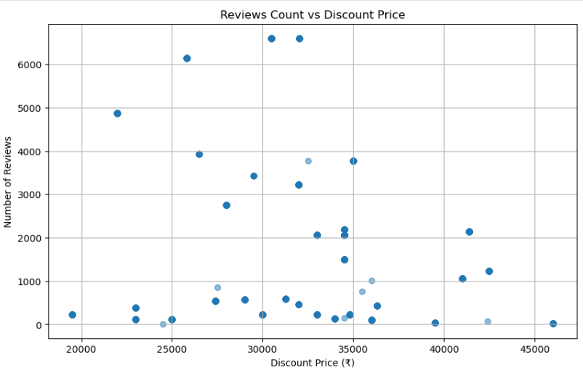
Bivariate Analysis:
Mid-range prices (₹25k–₹32k) attract the highest review volumes, including several peaks above 6,000 reviews, suggesting stronger demand or popularity in this band.
Higher-priced items (₹38k–₹46k) generally receive fewer reviews, indicating lower purchase volume or niche buyers at premium prices.
There is no strong linear relationship between discount price and reviews overall—reviews vary widely at similar prices, implying factors beyond price (brand, features, promotions) drive engagement.

Slide 16
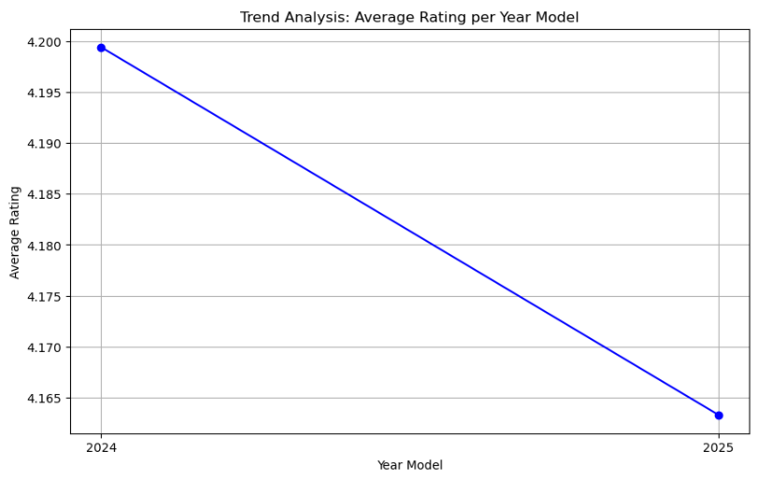
Bivariate Analysis:
There is a slight decline in average rating from 2024 to 2025. The average rating drops from roughly 4.2 in 2024 to about 4.164 in 2025.
The decrease is small (~0.036), indicating the ratings are fairly stable year-over-year, but there is a negative trend.
The line is smooth with only two points, so it suggests no major fluctuations in this timeframe.

Slide 17
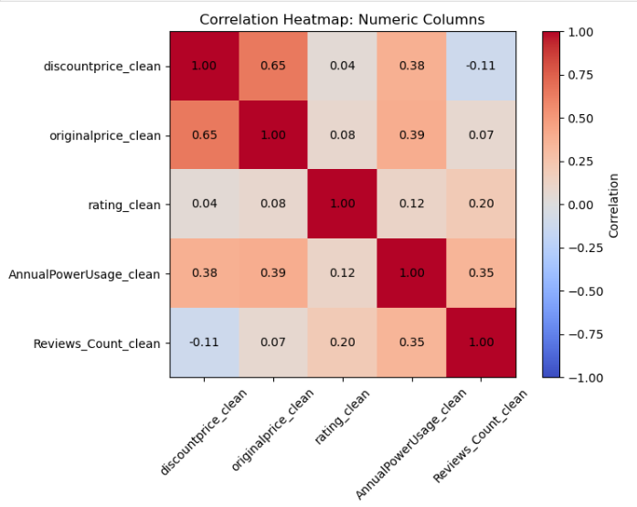
Multivariate Analysis:
Price and Discount Relationship: Original Price and Discount Price are strongly positively correlated (0.65), meaning higher-priced products receive higher discounts.
Product Features Influence Price: Annual Power Usage moderately correlates with prices (0.38–0.39), showing that higher power-consuming products tend to be more expensive.
Customer Feedback Less Impactful: Ratings and Reviews Count have weak correlations with prices, indicating that popularity or ratings do not strongly affect pricing.

Slide 18
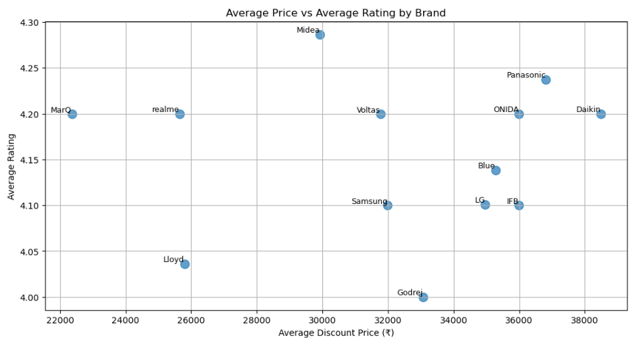
Multivariate Analysis:
Midea, MarQ, and realme offer high ratings (~4.2–4.29) at lower to mid-range prices (~₹22,000–30,000), providing strong value for money.
Daikin and Panasonic are the most expensive (~₹36,500–38,500) with good ratings (~4.2–4.24), appealing to customers seeking premium options.
Godrej has a relatively low rating (~4.0) despite a mid-to-high price (~₹33,000), indicating weaker perceived value.

Slide 19
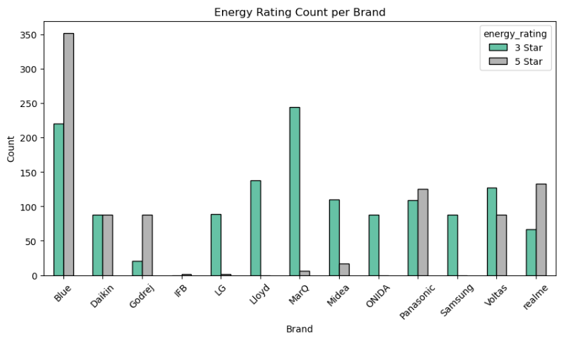
Multivariate Analysis:
Blue has the highest number of both 3-star and 5-star energy-rated products, indicating a wide and energy-diverse product portfolio.
Some brands like MarQ and LG are dominated by 3-star ratings, while Godrej, Panasonic, and realme show a stronger presence of 5-star models.
Several brands (e.g., IFB, Lloyd, ONIDA) have very few or almost no 5-star products, suggesting limited focus on top energy efficiency.

Slide 20
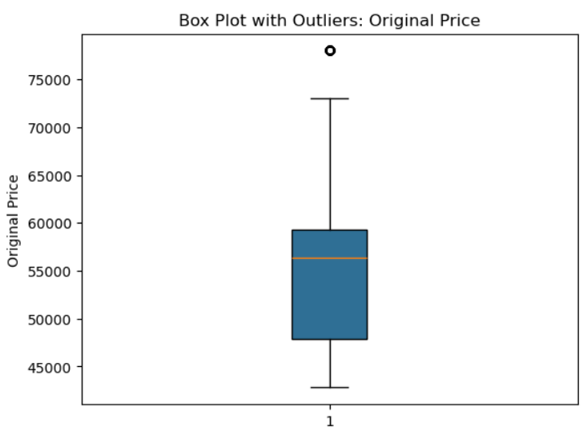
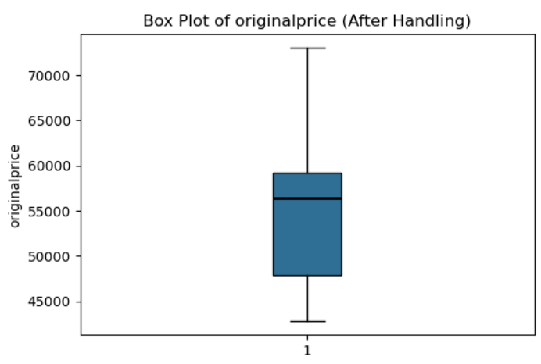
Handling Outliers:
Outlier handling removed extreme high prices without changing the median, making the price distribution more representative and reliable for analysis.

Slide 21
Conclusion:
Product Focus & Brand Positioning:-
Flipkart mainly features 2025 air conditioner models, highlighting its focus on newer products and technologies.
Premium brands target high-end buyers, while budget brands serve price-sensitive customers.
Pricing, Ratings & Customer Satisfaction:-
Attractive discounts are offered across all brands, but higher prices do not guarantee better ratings.
Mid-range and budget brands often deliver high customer satisfaction and better value for money.
Energy Efficiency & Value for Money:-
Most ACs are 3-Star rated, with limited availability of 5-Star energy-efficient models.
Buyers should prioritize energy efficiency, brand reliability, and features over price alone.

Slide 22
Experiences & Challenges:
Collecting data through web scraping offered hands-on experience with real e-commerce data, but frequent layout changes and inconsistent tags made extraction complex.
Cleaning the dataset was time-consuming due to mixed text–numeric formats, missing values, and unstandardized product features.
Handling outliers and feature extraction required multiple iterations to ensure accuracy without losing meaningful information.
Interpreting customer reviews and ratings was challenging, as they did not always directly align with price or product specifications.

Slide 23

THANK YOU

